Slide 1
Missouri Medicaid Audit and Compliance Annual Update Meeting 2019 Karen Burger, Provider Review Analyst Randy Mosher, Medicaid Unit Supervisor Randy.Mosher@dss.mo.gov – (573) 751-3399
Consumer Directed Services (CDS) Reports, annual Audits, Taxes

Slide 2
Consumer Directed Service Financial and Service Reports
Regulation
Where do you find the report forms?
When are they due?
Changes.
Issues.
MMAC.CDS@dss.mo.gov

Slide 3
Regulation
19 CSR 15-8.400
(2) Vendors shall perform, directly or by contract, payroll and fringe benefit accounting functions for consumers, including but not limited to:
(A) Collecting timesheets and certifying
their accuracy;
(B) Transmitting individual payments to
the personal care attendant (attendant) on
behalf of the consumer; and
(C) Ensuring all payroll, employment, and
other taxes are paid timely.
MMAC.CDS@dss.mo.gov

Slide 4
Regulation (cont)
(7) Vendors shall comply either directly or by contract, with the following fiscal requirements:
(G) Quarterly financial reports shall be
submitted to DHSS thirty (30) days after the end of each calendar quarter;
(H) Quarterly service reports shall be submitted to DHSS thirty (30) days after the end of each calendar quarter;
(I) Maintain CDS financial records separately from any other financial records and make all consumer and CDS financial
records, documents, reports and data available to DHSS upon request; and
MMAC.CDS@dss.mo.gov

Slide 5
Regulation (cont)
(J) Submit an annual audit by a properly
licensed independent practitioner (certified public accountant licensed in the state of Missouri) pursuant to applicable federal and state laws and regulations, including any audit parameters as established by DHSS.
1. The audit report must be submitted to DHSS within one hundred fifty (150) days after the end of the vendors fiscal year.
MMAC.CDS@dss.mo.gov

Slide 6
Personal Care Manual
13.11.B PROVIDER – GENERAL ADMINISTRATIVE REQUIREMENTS
• Providers must perform, directly or by contract, payroll and fringe benefit
accounting functions for participants, including but not limited to:
• Collecting timesheets and certifying their accuracy;
• Transmitting individual payments to the personal care attendant on behalf of the consumer ;
• Ensuring all payroll, employment, and other taxes are filed and paid timely under the consumer’s tax ID#;
• File claims for MO HealthNet reimbursement;
• Processing of consumers’’ and/or attendants’ inquiries and problems;
• Public information, outreach and education activities to ensure that persons with disabilities are informed of the services available and have maximum
opportunity for participation;
• Maintain confidentiality of consumer’s records, including eligibility information from DSDS, according to federal and state laws and regulations;
MMAC.CDS@dss.mo.gov

Slide 7
Personal Care Manual (cont)
Perform case management activities with the consumer at least monthly to
provide ongoing monitoring of the provisions of services in the plan of care and
other services as needed to live independently;
• Ensure the consumer has an emergency and/or back up plan;
• Monitor utilization of units by the consumer at least monthly; and Providers must maintain a list of eligible attendants:
Ensuring that each attendant is registered, screened, and employable according to the Family Care Safety Registry (FCSR), the Office of Inspector General (OIG) and the Employee Disqualification List (EDL) maintained by DHSS, and applicable state laws and regulations; and
• Notifying the attendant of his or her responsibility to comply with applicable state laws and regulations regarding reports of abuse or neglect.•
MMAC.CDS@dss.mo.gov

Slide 8
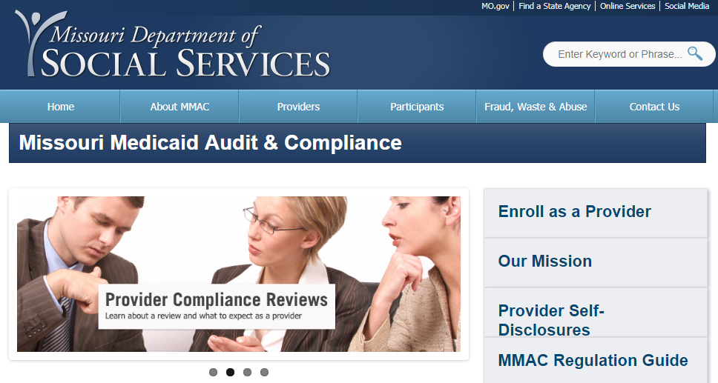
MMAC.MO.GOV Website
MMAC.CDS@dss.mo.gov

Slide 9
MMAC.MO.GOV Website (cont)
From the MMAC Home Page
Click on Providers
Click on Home and Community Based Services
MMAC.CDS@dss.mo.gov

Slide 10
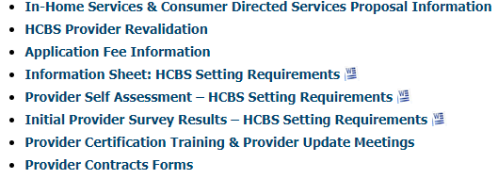
MMAC.MO.GOV Website (cont)
From the Home and Community Based Services Page:
Click on Provider Contracts Forms
MMAC.CDS@dss.mo.gov

Slide 11
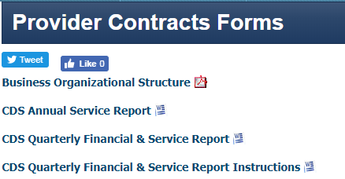
MMAC.MO.GOV Website (cont)
MMAC.CDS@dss.mo.gov

Slide 12
CONSUMER DIRECTED SERVICES FINANCIAL & SERVICE REPORT
Quarterly Report
Annual Service Report
MMAC.CDS@dss.mo.gov

Slide 13
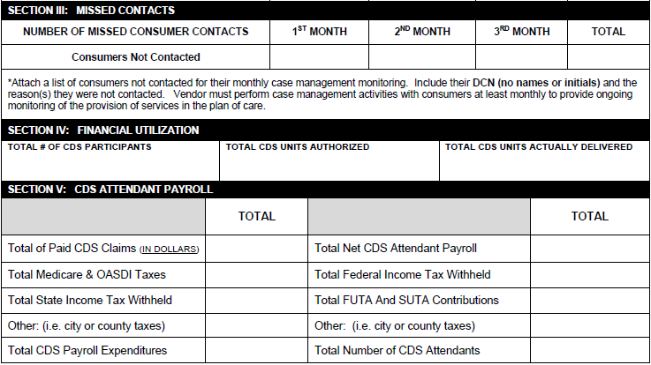
Quarterly Report
MMAC.CDS@dss.mo.gov

Slide 14
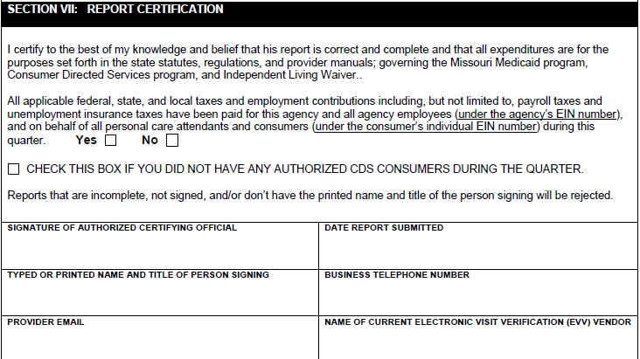
Quarterly Report (cont)
MMAC.CDS@dss.mo.gov

Slide 15
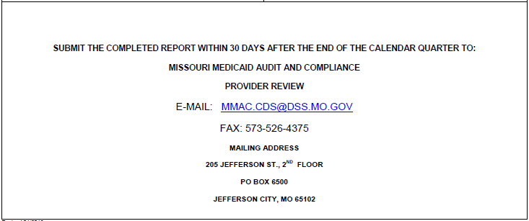
Quarterly Report (cont)
JANUARY 1 THROUGH MARCH 31
DUE BY APRIL 30
APRIL 1 THROUGH JUNE 30
DUE BY JULY 31
JULY 1 THROUGH SEPTEMBER 30
DUE BY OCTOBER 31
OCTOBER 1 THROUGH DECEMBER 31
DUE BY JANUARY 31
MMAC.CDS@dss.mo.gov

Slide 16
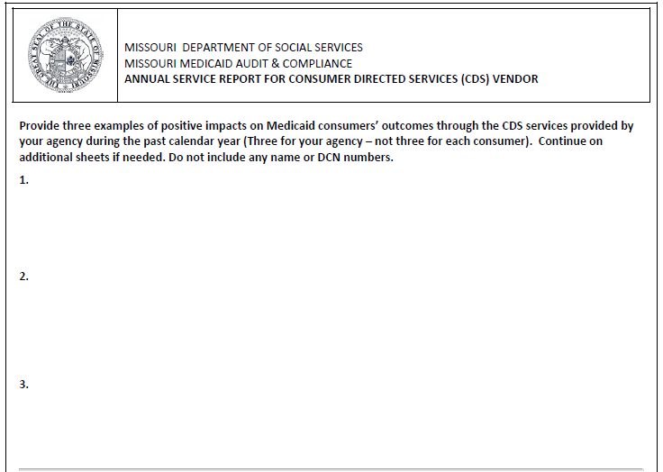
ANNUAL SERVICE REPORT FOR CONSUMER DIRECTED SERVICES (CDS) VENDOR
MMAC.CDS@dss.mo.gov

Slide 17
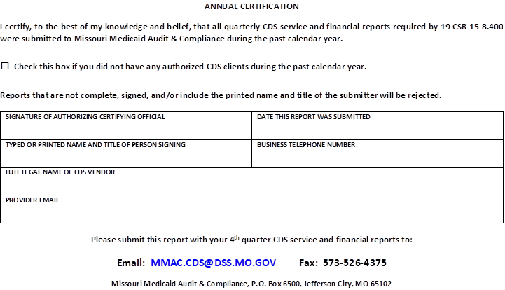
ANNUAL SERVICE REPORT FOR CONSUMER DIRECTED SERVICES (CDS) VENDOR (cont)
MMAC.CDS@dss.mo.gov

Slide 18
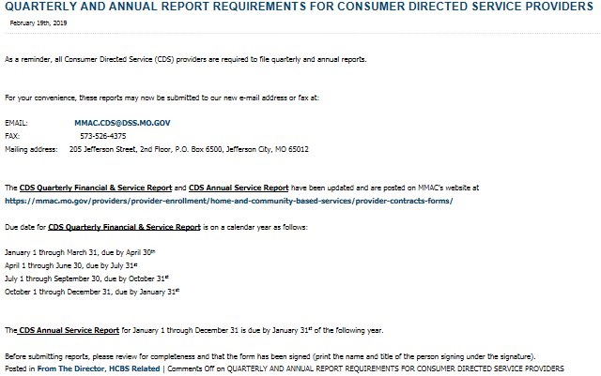
MMAC From The Director
MMAC.CDS@dss.mo.gov

Slide 19
Annual Audit
Reminder:
The Annual Audit needs to be completed by a CPA.
Needs to be completed no longer than 150 days from the end of the companies fiscal year. (Keep in mind the CPA’s busiest time of year is tax season so plan ahead in order to have your audit completed on time.)
Is your company financially stable?
MMAC.CDS@dss.mo.gov

Slide 20
CDS Taxes
Regulation
Tax Presentations
From the Director Bulletin
CDS Tax Project
Concerns and Issues
MMAC.CDS@dss.mo.gov

Slide 21
CDS Taxes (cont)
MMAC.CDS@dss.mo.gov

Slide 22
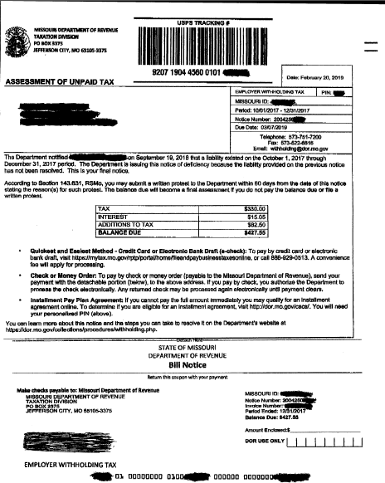
CDS Taxes (cont)
MMAC.CDS@dss.mo.gov

Slide 23
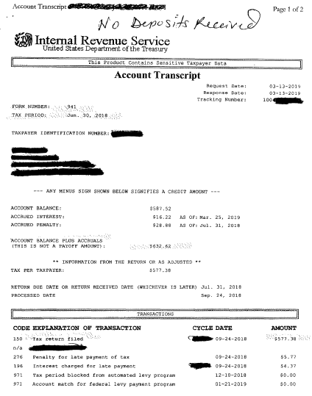
CDS Taxes (cont)
MMAC.CDS@dss.mo.gov

Slide 24
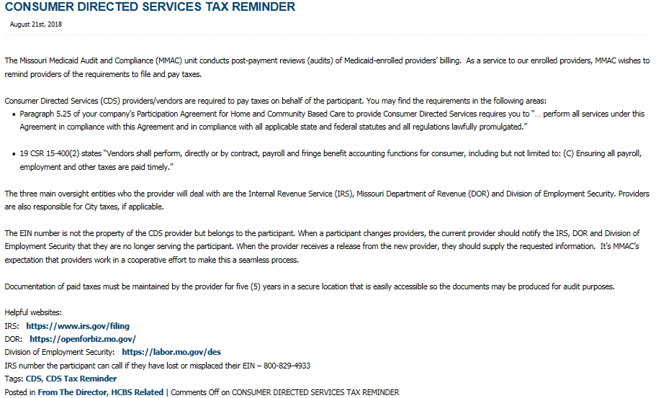
MMAC From The Director
MMAC.CDS@dss.mo.gov

Slide 25
Other Topics
Prior Authorization Project
Hospital Overlap Project
Insurance for In-Home Providers
State Transition Plan
Change Request Forms
MMAC.IHSContracts@dss.mo.gov
Legislation
MMAC.CDS@dss.mo.gov

Slide 26
Contact
Randy.Mosher@dss.mo.gov
MMAC.CDS@dss.mo.gov
MMAC.CDS@dss.mo.gov

Slide 27
Thank You
MMAC.CDS@dss.mo.gov

