Slide 1
Division of Senior and Disability Services
MMAC Provider Update
October 22, 23, 24, 2019
Jefferson City, MO

Slide 2
Organizational Structure
Division of Senior and Disability Services(DSDS)
  Section of Home and Community Based Services (HCBS)
    Bureau of Long Term Services and Supports
    Bureau of HCBS Systems and Data Reporting
    Bureau of HCBS Intake and Person Centered Care Planning (PCCP)
    Bureau of Home and Community Based Services
  Section of Adult Protective Services (APS)
    Bureau of Adult Protective Services
    Bureau of Central Registry Unit
    Bureau of APS Automation and Data Analysis
    Special Investigation Unit (SIU)
Notes:
Send to Jerry and Greg Backers and cc Marcia Patrickus

Slide 3
Home & Community Based Services
Section of HCBS
Venice Wood
Bureau of HCBS
Bureau of Intake & PCCP
Bureau of LTSS
Bureau of Systems & Data

Slide 4
Adult Protective Services
Section of
APS
Tim Jackson
Bureau of APS
Bureau of Automation & Analysis
Bureau of Central Registry Unit
Special Investigations Unit
Notes:
Change with Jerry’s changes

Slide 5
Statistics
Participant Statistics
Reassessments Statistics
Intake Unit Statistics
Employee Disqualification List (EDL) Statistics

Slide 6
Consumer Directed vs.
Agency Model Participants
Consumer Directed
Agency Model
30,594 Participants
34,024 Participants

Slide 7
Participant Statistics
Number of Participants per Waiver Type
Waiver Type | Participants | Slots Available
Aged and Disabled Waiver | 14,990 | 26,932
Adult Day Care Waiver | 1,618 | 3,600
Independent Living Waiver | 578 | 600

Slide 8
Reassessment Statistics
Number of Participants Reassessed by Type 27 Providers and DSDS Staff
Service Type | Total
DSDS Reassessments | 19,470
Provider Reassessments | 32,851
Total Reassessments | 52,321
Initial Referrals | 15,714

Slide 9
Type 27 Provider Statistics
Total number of active Type 27 Providers: 236
Breakdown of Active Providers
AAA | 9
RCF/ALF | 73
Agency Model Only | 49
CDS Only | 31
Agency, CDS, & ADC | 2
Agency & CDS | 65
CDS & ADC | 1
Notes:
Total number of active Type 27 Providers – 236
The Breakdown
AAA – 9
RCF/ALF – 73
Agency Only – 49
CDS Only – 31
ADC Only – 6
Agency, CDS and ADC – 2
Agency and CDS – 65
CDS and ADC - 1

Slide 10
Call Center Stats
 | Calls Presented | Calls Handled | Call Handle Rate
July | 3,488 | 2,652 | 76.03%
August | 3,726 | 2,597 | 69.70%
September | 3,429 | 2,647 | 77.19%
Notes:
Historical Perspective:
Deflected Calls- 744 (CY 2017) to 48,622 (CY 2018)→ 6,432% increase
7,550 (CY 2019 to date)→ Decreased Deflected Calls by 79% since CY 2018.
Lean Six Sigma Time Study:
“We can’t do today’s job with yesterday’s methods and meet the expectations of those that we serve tomorrow.”
In order to ensure that program demand and expectations are met, the prescreen process was reviewed and analyzed to ensure that the process was as efficient as it could be for those that we serve. To develop the restructured process, the HCBS Call Center underwent a time study by the DHSS Lean Six Sigma Team. The team is an operational excellence, or process improvement, group that is certified by Dartmouth University.
DHSS Lean Six Sigma Time Study Utilized the DMAIC model to:
-Define the scope of the problem and determine objectives
-Measure the current process, validate the measurement system, and quantify process performance
-Identify potential causes of issues and non-value process steps. Each step of the process was labeled as:
Value Add: Essential to delivering a service to a customer
Business Value Add: Steps needed to execute the “Value Add” work
Business Non Value Add: Steps that don’t add value, but must be done
Non Value Add: Steps that add no value and are not required to reach a goal
Generate a list of recommendations that eliminated the “Non Value Add” (important to note that the process mapping kept the participant, those who we serve, in focus.
Create a monitoring plan and finalize the transition to a streamlined process
Change Efforts:
-Increase Queue Size (2 hold spots to 4 hold spots, the maximum)
-Electronic Referral Implementation: Paperless
-Unified Responses: Electronic Templates
-Operational Schedule Changes: Shifts, Rotations, & Check-ins
-Provider Education/Outreach Streamlining & Collaboration
Presently Being Implemented (by January 2020):
-Outbound Call Dialer
-Automate Prescreen Notification
-HCBS-1 Revision
-One Attempt
-Eliminate Courtesy Calls
-Eliminate FRED Demographic Entry
-Additional Monitors
-Call Menu Scripting
-Website Redesign & Analysis
Additional Long-Term Recommendations for Implementation:
System Modifications & Interfacing
Online Referral Submissions
Prescreen Completion when LOC is Met
Reordering Prescreen Questions

Slide 11
Call Center Stats
 | Electronic Referrals | Prescreens Complete
July | 3,488 | 2,652
August | 3,726 | 2,597
September | 3,429 | 2,647
Notes:
Historical Perspective:
Electronic Referrals- 6,198 (CY 2017) to 13,494 (CY 2018)→ 118% increase
8, 539 (CY 2019 to date)→ Increased by 32% since CY 2018.
(SAME NOTES AS PREVIOUS SLIDE BELOW)
Lean Six Sigma Time Study:
“We can’t do today’s job with yesterday’s methods and meet the expectations of those that we serve tomorrow.”
In order to ensure that program demand and expectations are met, the prescreen process was reviewed and analyzed to ensure that the process was as efficient as it could be for those that we serve. To develop the restructured process, the HCBS Call Center underwent a time study by the DHSS Lean Six Sigma Team. The team is an operational excellence, or process improvement, group that is certified by Dartmouth University.
DHSS Lean Six Sigma Time Study Utilized the DMAIC model to:
-Define the scope of the problem and determine objectives
-Measure the current process, validate the measurement system, and quantify process performance
-Identify potential causes of issues and non-value process steps. Each step of the process was labeled as:
Value Add: Essential to delivering a service to a customer
Business Value Add: Steps needed to execute the “Value Add” work
Business Non Value Add: Steps that don’t add value, but must be done
Non Value Add: Steps that add no value and are not required to reach a goal
Generate a list of recommendations that eliminated the “Non Value Add” (important to note that the process mapping kept the participant, those who we serve, in focus.
Create a monitoring plan and finalize the transition to a streamlined process
Change Efforts:
-Increase Queue Size (2 hold spots to 4 hold spots, the maximum)
-Electronic Referral Implementation: Paperless
-Unified Responses: Electronic Templates
-Operational Schedule Changes: Shifts, Rotations, & Check-ins
-Provider Education/Outreach Streamlining & Collaboration
Presently Being Implemented (by January 2020):
-Outbound Call Dialer
-Automate Prescreen Notification
-HCBS-1 Revision
-One Attempt
-Eliminate Courtesy Calls
-Eliminate FRED Demographic Entry
-Additional Monitors
-Call Menu Scripting
-Website Redesign & Analysis
Additional Long-Term Recommendations for Implementation:
System Modifications & Interfacing
Online Referral Submissions
Prescreen Completion when LOC is Met
Reordering Prescreen Questions

Slide 12
HCBS Updates
A Review of the PM/VMs
PM-20-08 Policy Clarification Questions - Updates
PM-20-07 Level of Care (LOC) Transformation – Update
PM-20-05 Electronic Visit Verification Educational Materials
PM-20-04 Provider Voluntary Termination Reminder
PM-20-03 Updates to the Home and Community Based Services (HCBS) Call Center
PM-20-02 Encrypting Emails

Slide 13
HCBS Updates
A Review of the PM/VMs
PM-20-01 NCIAD Survey
PM-19-10 Fiscal Year (FY) 2020 Services Reimbursement Rates
PM-19-09 Changes to Electronic Visit Verification (EVV) Requirements
PM-19-08 Level of Care (LOC) Transformation Project – Release of Draft LOC Algorithm 2.0 ◦
PM-19-07 State Transition Plan
PM-19-06 April 2019 Medicaid Income Standards
PM-19-05 Level of Care (LOC) Transformation Project – Update

Slide 14
HCBS Updates
Structured Family Caregiver Waiver
Level of Care Transformation
Provider Reassessment Training
ILW Waiver Slots
Rate Study
Value Based Purchasing
NCI-AD
Notes:
SFCW – Public hearing done in September, comment period closed on the 21st, will be submitted to CMS in November, If approved implementation in July 2020
LOC – Looking at Mercer data, tweaking algorithm and looking at more data, appropriations needed for IT next budget, update regs/waivers/policies, appropriations for implementation in 2021, implementation July 2021
Provider Reassessment Training – next one is in December
ILW Slots – 200 extra, send people if you think someone would be good on it
Rate Study – Releasing the end of the year, used as an informational tool for those making decisions regarding rate setting.
VPB – technical assistance ended, still collaborating with DMH, DSS, and stakeholders on an initiative that is applicable to personal care across agencies
NCI-AD – 2nd year, 2,441, remind providers that if they are receiving calls from surveyors it’s okay to release participant info, why we do it

Slide 15
Special Investigation Unit
Information from March 2019 - Current
Employee Disqualification List | 105
Missouri Medicaid Audit and Compliance | 50
Prosecuting Attorney | 39
Notes:
Get from Jerry

Slide 16
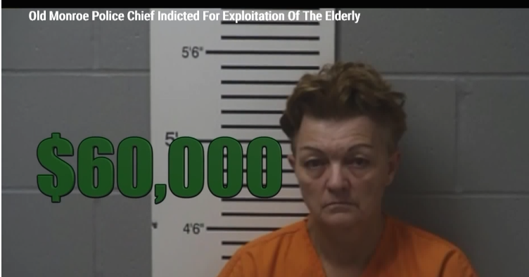
Old Monroe Police Chief Indicted for Exploitation of the Elderly (Lincoln County)

Slide 17
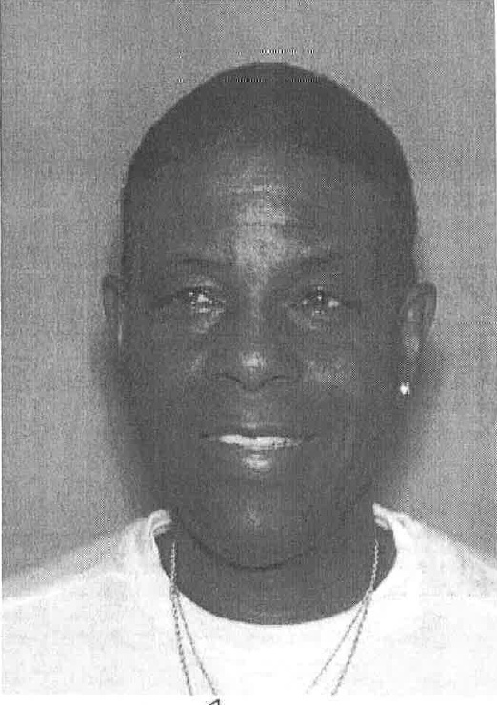
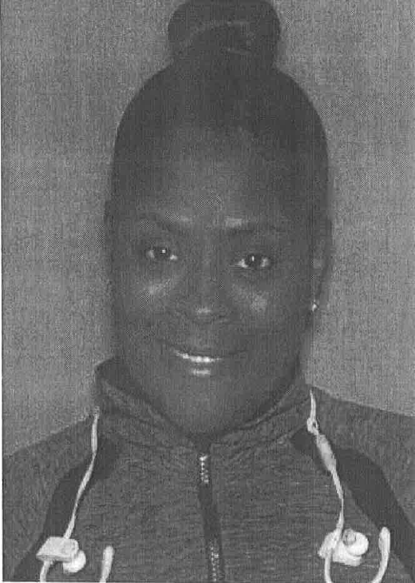
Two Indicted for $110,000 in CDS Fraud (St. Louis County)
Will Adams
LaShonda Johnson

Slide 18
Adult Abuse and Neglect Hotline
Online Reporting
Coming Soon!
Be our partner in making sure all cases of abuse, neglect and financial exploitation get reported.
www.health.mo.gov
Notes:
The Hotline receives thousands of call each month and many have experienced long wait times or even have been unable to get through at all at certain peak call times.
The Department wants to make sure all cases get reported and mandated reporters have a smooth experience in ensuring their compliance.
Online reporting will be in place before the end of the year and the Department will send out notice at that time.
Over 50% of reports come in from a mandated reporter, so with your partnership to use the online reporting, we can make sure every call gets answered at the hotline.

Slide 19
Questions?
Contact
The Bureau of Long Term Services and Supports
LTSS@health.mo.gov
(573) 526-8557
Special Investigations Unit
siu@health.mo.gov

