Slide 1

Missouri Medicaid Audit & Compliance
Consumer Directed Program (CDS) Orientation
Cindy Werdehausen
Medicaid Specialist-Contracts Unit
Missouri Department of Social Services
205 Jefferson St., 2nd Floor, P.O. Box 6500
Jefferson City, MO 65102-6500
(573) 751-3399 (Telephone)
(573) 634-3105 (Electronic-Fax)
mmac.ihscontracts@dss.mo.gov

Slide 2
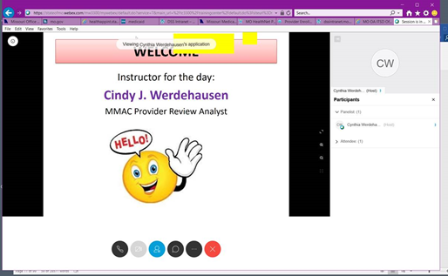
Housekeeping
The presentation will be easier to follow if you make your view “full screen”
You may submit questions using the CHAT option. Send questions to the “Panelists”; they will be the moderators for this training
After each section, we will take a few minutes to answer questions submitted via CHAT Box

Slide 3
Housekeeping
If you get disconnected, you clink on the telephone button or “Audio” and then click connect.
We will be taking two breaks during the training to allow people to get up and move around, bathroom, stretch, etc.

Slide 4
Topics covered today
Consumer Program Overview
Proposal Submission/Process
HIPAA/Office Space
Guidance
Screenings
Taxes
MMAC Investigations
Provider Review-EVV
CDS Providers – Keys to Success
Certificates

Slide 5

CONSUMER PROGRAM OVERVIEW

Slide 6
What IS Consumer Directed Services ?
Missouri’s state Medicaid program, referred to as MO HealthNet, offers a consumer directed personal care program. Consumer Directed Services (CDS), also referred to as self-directed care, allows eligible applicants to hire, train, and supervise the individual(s) they choose to provide their personal care.
Family members can be hired to provide care. An exception are spouses and legal guardians.

Slide 7
What IS CDS? (cont.)
This personal care program is administered by the Division of Senior and Disability Services, a division of Missouri Department of Health and Senior Services (DHSS), and is available state wide.
Missouri Medicaid Audit and Compliance (MMAC) processes the contracts and MO HealthNet enrollments for CDS providers.

Slide 8
What IS CDS? (cont.)
While this program is not limited to the elderly, it does assist seniors who are unable to perform routine daily activities due to illness, such as cancer or kidney failure. Assistance is provided with daily living activities including toiletry, mobility, cooking, and light housekeeping.
CDS appeals to younger disabled individuals because the services can be provided by a qualified family member, though not a spouse or legal guardian. The time of service delivery is determined by the consumer and the attendant may transport the consumer.

Slide 9
What IS CDS? (cont.)
The attendant is NOT the employee of the CDS vendor/provider but the employee of the consumer.
Vendor/providers bear the responsibility of training the consumer.
Any issues concerning attendant screening, time keeping, taxes being paid under the consumer’s EIN and repayment of funds to the state are the responsibility of the vendor/provider.

Slide 10
Main Responsibility of a CDS Provider
The care of the client, participant, consumer, what ever term you use; their care is your #1 priority.
Notes:
The client comes first! Your are a provider to administer care to the client first.

Slide 11
Where do I get information on how to be a CDS Provider?
MMAC.MO.GOV – under Proposal for Contract
CDS General Information
https://mmac.mo.gov/providers/provider-enrollment/home-and-community-based-services/contract-proposal-information/consumer-directed-services-general-information/
Information that can be found:
Program Requirements
State Regulations (CSR)
Personal Care Provider Manual
State Statutes (RSMo)-August 2020 Updates (208.900 - 935)
Notes:
Again, same rules and regulation that we (MMAC) will hold you accountable. When reviews are done of your documentation, billing, training and screenings; this is where we pull the requirements that you will be accountable for.
General Information: Save this somewhere with your favorites; it is a handy quick reference tool to have at your disposal.
Make a book to keep as a Program reference guide.

Slide 12
REGULATIONS - CSR
As a CDS provider you are held accountable to the Missouri Code of State Regulations along with CDS Program Requirements
19 CSR 15-8.100 through .500 – CDS
19 CSR 30-82.060 – Hiring Restrictions
13 CSR 70-3.020 – Title XIX Provider Enrollment
13 CSR 70-3.030 – Sanctions for False & Fraudulent Claims to MO HealthNet
Notes:
Keep these handy; these are the rules and regulations that as CDS provider you will be held to.
Make notes for quick reference on common issues you come across when writing your policies or once you start servicing consumers.

Slide 13
CDS Program Statistics
CDS Clients per county
CDS Vendors per county
CDS Vendors to Client

Slide 14
Commonly Used Acronyms
DHSS Department of Health & Senior Services
DSDS Division of Senior & Disability Services
DSS Department of Social Services
MHD MO HealthNet Division
MMAC Missouri Medicaid Audit & Compliance
CSR Code of State Regulations
RSMo Revised Statutes of Missouri
FCSR Family Care Safety Registry
EDL Employee Disqualification List
GCW Good Cause Waiver
EVV Electronic Visit Verification

Slide 15
The DEPARTMENTS
DHSS
Department of Health & Senior Services
MMAC
Missouri Medicaid Audit & Compliance
DSS
Department of Social Services
DSDS
Division of Senior & Disability Services
MHD
MO HealthNet Division
Notes:
DSDS is a division under DHSS – they are NOT the same thing; you can’t interchange them
MMAC and Mo HealthNet are under DSS

Slide 16
How We All Work Together
MMAC – Contract / Enrollment /Provider Review/Investigations
https://mmac.mo.gov/providers/provider-enrollment/home-and-community-based-services/
DHSS/DSDS – Participant Care
https://health.mo.gov/seniors/hcbs/
DSS/MHD – Billing / Claims processing
https://dss.mo.gov/mhd/providers/fee-for-service-providers.htm
Notes:
MMAC - reviews proposals for approved and then enrolls providers
Once you become a provider; with in a year or two, an analyst with Provider Review will contact in regards to doing a record review.
DSDS is a division under DHSS; Contact DSDS in regards to client care, referrals or changes need to care plans.
MHD is a division under Social Services; contact them in regards to billing issues, procedure codes, claim processing/denials, and pay cycles.

Slide 17
MMAC
Proposal/Approved
Enrollment/Changes per Provider/Provider Review/Invest.
www.mmac.mo.gov
DSDS
Cyber Access
Set Policies and Participant Care
www.health.mo.gov
MHD
eMOMED
Billing, Claims, and Education
www.dss.mo.gov
Notes:
MMAC - reviews proposals for approved and then enrolls providers; any changes to your business (address, phone, banking, etc.) will be done through MMAC
Once you become a provider; with in a year or two, an analyst with Provider Review will contact in regards to doing a record review. MMAC also audits, investigates and imposes sanction on providers.
DSDS is a division under DHSS; Contact DSDS in regards to client care, referrals or changes need to care plans. DSDS policies govern the CDS program; policy and program questions also need to go to DSDS.
MHD is a division under Social Services; contact them in regards to billing issues, procedure codes, claim processing/denials, and pay cycles.

Slide 18

QUESTIONS

Slide 19

Proposal Submission & Process

Slide 20
Proposals
Make sure that you are submitting a COMPLETE proposal
Use the checklist on the Proposal for Contract
https://mmac.mo.gov/wp-content/uploads/sites/11/2019/05/CDS-PROPOSAL-CHECK-LIST.pd_.pdf
Make sure you have included everything on the checklist and that you are sending the documentation requested.
Notes:
When you check something off on the checklist, make sure that what you are submitting is what is asked for.
Ex: where asked for a Vendor No Tax Due letter; people submit a Certificate of No Tax Due – not the same thing and not what is asked for.
Use the correct Legal Name on all forms; if using a DBA then include that on the forms as well
Our forms are not set up to trick you in any way; just make sure you are putting the requested information in the correct box. And if the form is asking for a signature and date; SIGN AND DATE IT!!! Write legibly.
They are numbered with the corresponding header as listed on the Proposal for Contract on separate sheets of paper or print front and back, just because there is room, do NOT put more than one policy per sheet of paper.
INCOMPLETE PROPOSAL WILL BE DENIED

Slide 21
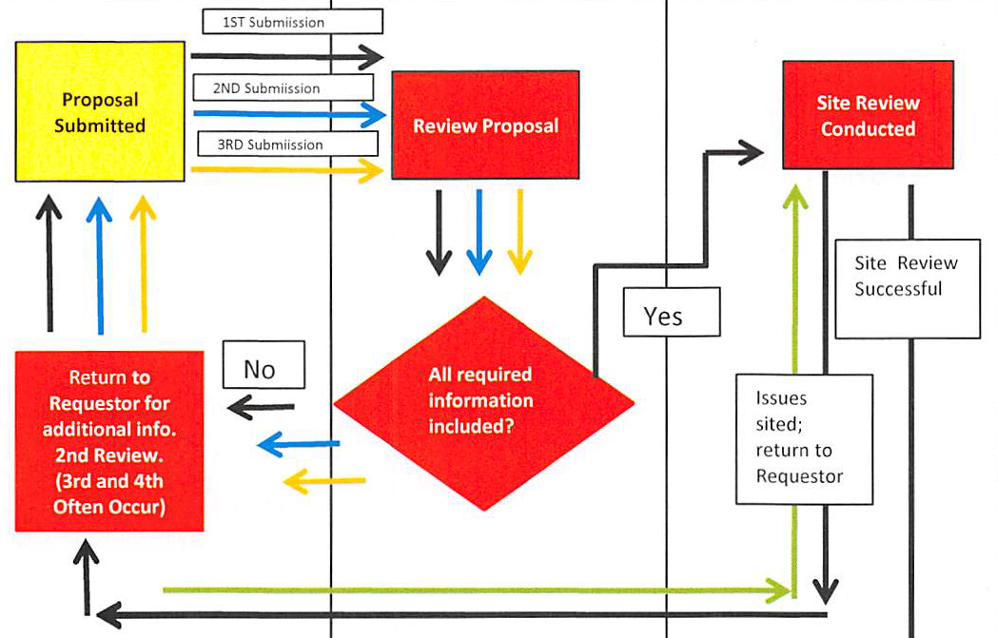
Proposal Process
Notes:
A lot of the process is repeated due to 3rd, 4th and even 5th reviews of documentation submitted.
Received – 30 days for 1st review; I send it back for corrections – provider then has 30 days to send corrections; corrections get put with the proposal and in line with the other pending; corrections are reviewed by the date they are received back at MMAC; if those corrections are still wrong or not everything was submitted; the cycle starts again; I send the review and the provider has 30 days to submit corrections; back in line you go for review.
Note: just because you had a site visit, doesn’t mean that you are approved; the pictures and checklist from the site visit must also be approved.

Slide 22
Proposal is Approved
Approved Proposal
Medicaid Enrollment forms are sent to the provider
Notification of Site Visit
Site Visit
MMAC representative will set a time for a virtual tour and go over the checklist
Contract
Provider Agreement mailed out
Application fee paid
Notification of any follow up needed will be sent out
Provider will fill out paperwork and send back the signed agreement along with the requested notarized work affidavit and E-Verify Signature Page)
MMAC will process the paperwork; finalize the enrollment
Will mail out the signed contract along with a Welcome letter
Once the site visit is completed, any additional pictures or documentation will be reviewed and processed
Notes:
Proposal Approved (enrollments forms filled out/application fee paid)
Site Visit (MMAC rep to see office and equipment)
Review of Site Visit (done at the office) follow up on anything that my be needed
Provider Agreement mailed (provider will then send back the signed agreement, notarized work affidavit and E-Verify signature page)
Once received back in the office; MMAC will finalize enrollment and mail out the signed contract and welcome letter.
Clarification - You will be contracted with DHSS and you also have a Title XIX contract for HCBS services with Medicaid.

Slide 23
Proposals
Make sure forms are filled out Correctly and Completely
(information where asked, signed and dated)
Policies and Procedures meet submission requirements
Have you followed the submission requirements listed on the website? Are your policies numbered? Are the headers there? Did you sign them? Etc.
https://mmac.mo.gov/providers/provider-enrollment/home-and-community-based-services/contract-proposal-information/
Notes:
Our forms are not set up to trick you in any way; just make sure you are putting the requested information in the correct box. And if the form is asking for a signature and date; SIGN AND DATE IT!!! Write legibly.
They are numbered with the corresponding header as listed on the Proposal for Contract on separate sheets of paper; please do not print front and back, and just because there is room and do NOT put more than one policy per sheet of paper.
INCOMPLETE PROPOSAL WILL BE DENIED

Slide 24
Purchased Proposals
Even though there isn’t a rule stating that you cannot buy your proposal -
The proposal you are submitting is for YOUR business; the whole purpose of the proposal process is to see that you understand the program, its requirements, and the rules and regulations that apply to it.

Slide 25
Proposals – Legal Business Name
Use the Legal Business Name throughout
When you register with the IRS; that is your legal business name and structure.
That legal name and structure must be used throughout the registration process and must all match each other.
IRS letter
Business Org. Structure
MO Secretary of State Office
MO Dept. of Revenue
Legal Business name use on all forms submitted with proposal.
Notes:
Use the correct Legal Name on all forms; if using a DBA then include that on the forms as well
AN INCOMPLETE PROPOSAL WILL BE DENIED

Slide 26
Example:
ABC Home Health Care LLC – IRS Letter
ABC Homehealth Care – MO Dept. of Rev
A B C Home Healthcare – Vendor No Tax Due
LLC:
ABC Home Health Care
Cindy Werdehausen – Sole Member
Sole Proprietor:
Cindy Werdehausen
ABC Home Health Care

Slide 27
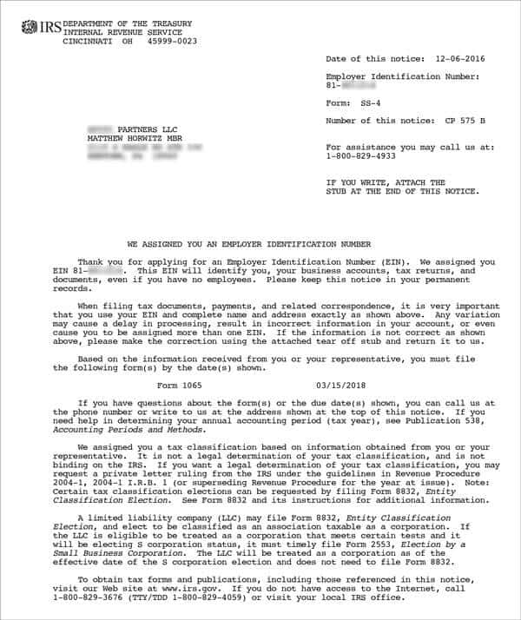
Example of Proof of Federal EIN

Slide 28
Proof of MO Tax ID (MO ID)

Slide 29
Example of Unacceptable Proof of MO Tax ID This is what I receive the most in proposals instead of the MO Dept. of Rev Registration Letter

Slide 30

QUESTIONS

Slide 31

HIPAA

Slide 32
HIPAA
Health Insurance Portability and Accountability Act of 1996
Federal Legislation that provides data privacy and security provisions for safeguarding medical information.
Notes:
I want to point TWO keep items used to describe HIPAA, PRIVACY and MEDICAL INFORMATION.
We get a lot of questions regarding office space and equipment that has a lock feature. MMAC asks for and looks for these item because of HIPAA. When billing, talking to client or to an attendant about a client, whether on the phone or via email, no one that is not associated with your provider should be able to hear you or look over your shoulder.
It is YOUR responsibility to keep information private, personal or medical. You can’t do that if your office is in your living room or a shared office with three other businesses.

Slide 33
HIPAA - Office Requirements
Office space dedicated solely to your provider
Privacy
Office with a door / not located in a common area
Lock on file cabinets and door
Safe guard to secure medical & personal information.
NO VIRTUAL offices
Notes:
We get a lot of questions regarding office space and equipment that has a lock feature. MMAC asks for and looks for these item because of HIPAA. When billing, talking to client or to an attendant about a client, whether on the phone or via email, no one that is not associated with your provider should be able to hear you or look over your shoulder.
It is YOUR responsibility to keep information private, personal or medical. You can’t do that if your office is in your living room or a shared office with three other businesses.

Slide 34
HIPAA VIOLATIONS
Gossiping/Sharing PHI
Improper disposal of records
Loss or theft of devices
Keeping unsecured records
Lack of employee training
3rd Party discussion - (others hearing your conversations)
Notes:
PHI – Protected Health Information

Slide 35
HIPAA
Taking client information from one provider and giving that information to another is a violation.
Consumer EIN’s do not belong to the CDS provider. Providing the consumer with THEIR EIN’s is not a violation. IT IS a violation when a CDS Vendor does not make the EIN available to a client who is transferring to another agency.
Notes:
MMAC receives frequent calls in regards to client’s not able to get their EIN when changing agencies.

Slide 36
HIPAA – Civil Penalties
Did not know; exercised diligence:
$100-$50,000 per violation up to $1.5 mil per year
Violation had reasonable cause but not willful:
$1000-$50,000 per violation up to $1.5 mil per year
Violation was due to willful neglect but corrected:
$ 10,000-$50,000 per violation up to $1.5 mil per year
Violation was due to willful neglect and not corrected:
$50,000 per violation up to $1.5 mil per year

Slide 37
HIPAA – Criminal Penalties
Unknowingly or with reasonable cause:
Up to ONE year jail sentence
Under false pretenses:
Up to FIVE years jail sentence
For personal gain or malicious reasons:
Up to TEN years jail sentence

Slide 38

QUESTIONS

Slide 39

Guidance

Slide 40
Guidance
TRUE or FALSE
When you have a question about a policy, procedure, screening or billing question, it’s good idea to ask your friend who is also a HCBS provider or maybe the other CDS that’s just down the hall?
Notes:
These people are your competition!!!! If you do something that is not in regulation because “someone” told you to; the consequences are going to be put on you, NOT on them.
Would not believe how many emails or telephone calls we get that include “I heard somewhere” or “Someone one told me” Unless it was from one of the three departments/divisions that handle HCBS program, I wouldn’t take it as fact.
Again, consider your source, do you think your competition is going to give you accurate information?

Slide 41
Guidance
If you don’t know, ask someone; but don’t ask just anyone.
Know which department/division you need to pose your question to.
Have your Legal Name and NPI at hand when emailing or calling with your question. Being prepared helps you and the person assisting you.
Notes:
Know Your Audience – Who do you call?
If a an attendant is turning in fraudulent EVV? – MMAC
If a participant need services? – DSDS
If you have a billing question? - DSS

Slide 42
Guidance
Review your proposal that you submitted, particularly your policies and procedures. 80% of the time the questions being asked are in the policies and procedures you submitted.
Utilize the resources available to HCBS Providers
Slides with website will be covered later in this presentation
Notes:
Know Your Audience – Who do you call?
If a an attendant is turning in fraudulent EVV? – MMAC
If a participant need services? – DSDS
If you have a billing question? - DSS

Slide 43

QUESTIONS

Slide 44


Screenings

Slide 45
Background Screenings
FCSR
Family Care Safety Registry
EDL
Employment Disqualification List
Notes:
These are two completely different screenings with different statues, rules and screening guidelines.
A lot of times, providers combine the requirements for the two together and they are not the same thing.

Slide 46
FCSR
Must Screen all employees and attendants prior to hire (yes, even those who will work in the office)
Screen against all aliases and SSNs they disclose on their employment application
DHSS recommends that FCSR screenings of employees be done on an annual basis (PM-VM 17-31)
If there is a finding on the FCSR, it is the provider’s responsibility to verify if the finding is a disqualifying factor, not MMAC’s.
Notes:
See is anyone needs clarification on what a disqualifying factor is? If they do proceed with the next couple of slide, if not skip pass them.
Mention FCSR presentation on MMAC website under Update Meeting

Slide 47
Information Reported in the FCSR Background Screening
Open Missouri Criminal History Records
Sex Offender Registry
Child Abuse/Neglect Records
Department of Health and Senior Services (DHSS) Employee Disqualification List
Department of Mental Health (DMH) Employee Disqualification Registry
Child Care License Revocations
Foster Parent License Denials, Revocations, Suspensions

Slide 48
Hiring May be Restricted
Disqualifying criminal offenses are found in 192.2495 RSMo.
A listing has been compiled and posted on the MMAC website
https://mmac.mo.gov/providers/provider-enrollment/home-and-community-based-services/fcsr-for-in-home-and-consumer-directed-services/
To determine if a criminal offense disqualifies an in-home or consumer directed services worker from employment, compare the listing with the RAP sheet.

Slide 49

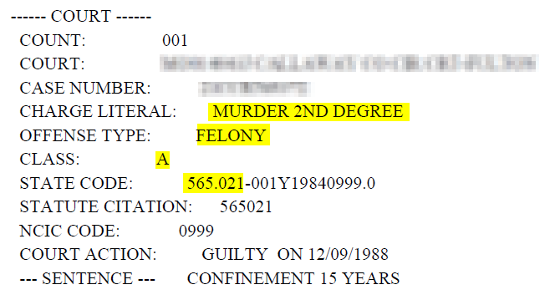
Hiring May be Restricted
When comparing the listing of disqualifying offenses with the RAP sheet, refer to the COURT section of each cycle.
Look at the CHARGE LITERAL
Look at the OFFENSE TYPE
Look at the CLASS
Look at the STATE CODE or STATUTE CITATION
Notes:
Exact match. Notice the date (1988) doesn’t matter.

Slide 50

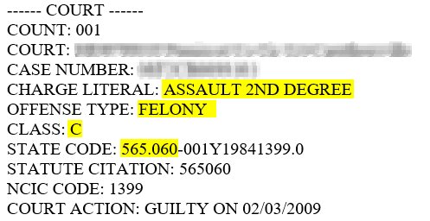
Hiring May be Restricted
When comparing the listing of disqualifying offenses with the RAP sheet, refer to the COURT section of each cycle.
Look at the CHARGE LITERAL
Look at the OFFENSE TYPE
Look at the CLASS
Look at the STATE CODE or STATUTE CITATION
Notes:
Near match – class C is not a match, statute differs

Slide 51
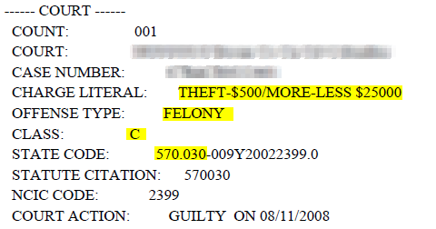
Hiring May be Restricted
When comparing the listing of disqualifying offenses with the RAP sheet, refer to the COURT section of each cycle.
Look at the CHARGE LITERAL
Look at the OFFENSE TYPE
Look at the CLASS
Look at the STATE CODE or STATUTE CITATION
Notes:
Match – because it is ANY felony (a little tricky since previous example was a C felony)

Slide 52
Documenting a finding
When a HP (highway patrol) finding show’s up and the crime is NOT a disqualifying factor – make note on the on the screening.
Your name
Date
Circle or notate the violation, class and citation code
Note that the finding is not a disqualifying factor and a GCW is not required
This will show MMAC/DSDS that further action was taken by the provider when the screening was made

Slide 53
Questions Regarding a Finding
You’ve done the screening, verified the criminal finding against the list and you’re not sure or have questions
MMAC – Provider Review
Tamara Wills
573-751-3399

Slide 54
EDL
RSMo 192.2490
Do Not Hire anyone listed on the EDL
Check against the EDL prior to hire and every quarter
https://health.mo.gov/safety/edl/index.php
Notes:
A lot of times policies are submitted that the employee is to be registered with EDL; NO THEY ARE NOT.
You Register with the FCSR; you screen to see if a possible or current employee is listed on the EDL.

Slide 55
OIG LEIE
Office of Inspector General (OIG)
List of Excluded Individuals/Entities (LEIE)
http://exclusions.oig.hhs.gov/
CDS Program Requirements 5.2
OIG LEIE – screen all employees and attendants must be screened monthly.
Notes:
5.2 The Vendor shall ensure all employees of the Vendor and all personal care attendants, including those related to the consumer are not listed on the U.S. Department of Health and Human Services, Office of Inspector General, List of Excluded Individuals/Entities (LEIE) (http://exclusions.oig.hhs.gov/). Employees and attendants must be screened monthly. All known aliases of the employees and personal care attendants must be screened. The Provider shall maintain in its files verification of the LEIE screenings. Any exclusion information discovered must be immediately reported to MMAC.

Slide 56

QUESTIONS

Slide 57

Taxes

Slide 58
TAXES – Basic Need to Know
Obtaining Federal, State and Local Employer Identification Numbers (EIN) on new and transferring Consumers
Reporting new hires to the state of Missouri
Filing quarterly and yearly taxes
Closing a CDS Customer/Consumer
Tax forms are always changing - watch for updates

Slide 59
TAXES
FORMS VENDORS NEED ON EACH NEW CONSUMER
FEDERAL
SS-4 Application (Federal EIN)
Form 8821 or 2848 POA & Declaration of Rep
(IRS wants the 8821 over the 2848)
Form 2678-Appoint of Agent (also used when closing a client)
STATE
Form 2643A-MO Tax Registration (State EIN)
Form 2827-Power of Attorney
Local/City (Kansas City & St. Louis)
Notes:
Mention the CDS Taxes presentation on the MMAC website AGAIN – never hurts to it drive home.
Examples of each of these forms is with the power point as well.
Power of Attorney for both federal & state is setting up the vendor to file taxes on behalf of the consumer.
Goes over the forms, why you will need them, how to process, errors that may occur and possible fixes.

Slide 60
What Taxes Do You File?
Federal 941 - quarterly or federal 944 – annually
MO 941 - quarterly or annually
Division of Employment Security Contribution and Wage Report - all quarterly
Local Quarterly Taxes (Kansas City & St. Louis)
W3/W2 – annually
MO W3 – annually
Local Annual Reconciliation (Kansas City & St. Louis)
Notes:
These are the taxes you file on behalf of the consumer

Slide 61
Reminder - Taxes
As a CDS vendor it is YOUR responsibility to make sure that taxes are filed and paid in a timely manner
Taxes are filed under the Consumer’s EINs and not the provider/vendor’s EINs
If a consumer decides to leave your CDS and go with another one, their EIN goes with them; it is NOT yours to keep.
Notes:
Can’t stress enough that the EIN belongs to the Consumer not the CDS Vendor Agency. If a client leaves, it is you responsibility to provide them THEIR information.

Slide 62
Employment Security
Here are some of the main items they want you to know
https://uinteract.labor.mo.gov/benefits/home.do
Encourage you to use the Contribution and wage reports and paying online at Uinteract1@labor.mo.gov. For more information on the file format call Danielle Childs 573-751-3422 or Dot Pfeiffer 573-751-2271
Remember to get all your clients reports and payments in a timely manner to stay in compliance
Notes:
https://uinteract.labor.mo.gov/benefits/home.do
When sending in paper reports, please make sure you are putting the CDS Vendor name as the C/O so that we know what unit the report needs to be processed under.
If paying for reports by mail with a check, we need individual checks for each report. Please do not write one check for multiple accounts.
If there is a credit on your clients account, please use that the following quarter. We will not be refunding any amounts under $10.00 unless the client is non-liable for the full year.

Slide 63

QUESTIONS

Slide 64
INVESTIGATIONS
75% of all referrals to the Investigations Unit
Involve CDS Vendors

Slide 65
FRAUD
This is when an individual or organization intentionally falsifies information for financial gain. One of the most common examples is a provider submitting claims to a payer for services never performed.
MEDICAID FRAUD:
RSMo 191.905
No health care provider shall knowingly make or cause to be made a false statement or false representation of a material fact in order to receive a health care payment.

Slide 66
For Providers:
The provider should not submit claims solely on the basis of the prior authorization, but must base claims upon documentation of actual services rendered.
Do Not Bill Off the Care Plan
Overlapping Services
If you bill for services while the participant is in the hospital or otherwise not receiving services, you may be guilty of stealing.
Do not bill for services when the participant has died. (That is stealing and fraud)
Notes:
570.030.1 A person commits the crime of stealing if he or she appropriates property or services of another with the purpose to deprive him or her thereof, either without his or her consent or by means of deceit or coercion.
Make sure you are verifying the time and services. If you bill for services that they consumer may have fraudulently submitted; Medicaid will take the money back from you, not the consumer. You may then file civilly for the money owed you.
MMAC will check data bases for dates of death.

Slide 67
Some Examples of Fraud
Overcharging for services provided
Charging for services NOT provided
Accepting bribes or kickbacks for referring clients
Incentives for retain clients
Rendering inappropriate or unnecessary services
Examples of Kickbacks
Offering cash, goods or service to prospective clients to switch / to clients to stay / to attendants for referrals
(cut grass for free if they stay or to have them switch)

Slide 68
Falsification of Documentation
The aide/attendant is believed to have falsified time on EVV reports if they:
Leave early, and do not adjust their Telephony
Arrive late, and do not adjust their Telephony
Not showing up but claiming time worked
Being in two (or 3) places at the same time
Using EVV while their client is in the hospital or otherwise not receiving care

Slide 69
CDS Providers/Vendors
For CDS, the attendant can be a family member but cannot be the spouse
Marriage Certificates are easy to find. $3.00 in St. Louis City
For In Home – a family member is defined as a Spouse, Parent, Sibling, Child by blood, adoption or marriage, Grandparent or Grandchild

Slide 70
IMPORTANT
As a CDS vendor, it is your responsibility to pay all taxes in a timely manner.
It is really not fair for an 85 yr old CDS client to receive a notice from the IRS saying they are taking her home or keeping her social security check to pay the taxes that your agency agreed to pay.
The investigators will contact you to produce the proper paperwork showing taxes were paid.

Slide 71

We Need Your Help
You’re a taxpayer . . . It’s your money!
More services for this in need
If you know about it and don’t report it, YOU are committing fraud. This is the easiest way to get terminated from the program
It’s the right thing to do

Slide 72
Contact Information
MMAC FRAUD HOTLINE: 573-751-3285
MMAC FRAUD EMAIL: MMAC.ReportFraud@dss.mo.gov
Policy Questions can be directed to:
Bureau of Program Integrity via email programintegrity@health.mo.gov
or by phone 573-526-8557

Slide 73

QUESTIONS

Slide 74

Provider Review Team - HCBS

Slide 75
Consumer Directed Services (CDS) program audit
Documentation
Family Care Safety Registry (FCSR)
Taxes
Electronic Visit Verification (EVV)

Slide 76
Documentation
Personal Care Aide Requirements
Documentations of Basic Training Requirements provided to the consumer/participant
Participant Case Record
Retention of Records
Check to make sure services are adequately documented

Slide 77
Family Care Safety Registry (FCSR)
Providers register aides with FCSR
Completed at time of hire and before contact with a participant
If there is a finding and depending on the finding was a Good Cause Waiver (GCW) obtained
Documentation kept for five years. We suggest notation of the decision be made on the screening with the date and name of the person who reviewed the information.
Notes:
And

Slide 78
Taxes Recap
FEDERAL
SS-4 Application (Federal EIN)
Form 8821 or 2848 POA & Declaration of Rep
Form 2678-Appoint of Agent
STATE
Form 2643A-MO Tax Registration (State EIN)
Form 2827-Power of Attorney
Local/City (Kansas City & St. Louis)

Slide 79
Taxes Recap
Federal 941 - quarterly or federal 944 – annually
MO 941 - quarterly or annually
Division of Employment Security Contribution and Wage Report - all quarterly
Local Quarterly Taxes (Kansas City & St. Louis)
W3/W2 – annually
MO W3 – annually
Local Annual Reconciliation (Kansas City & St. Louis)

Slide 80
Electronic Visit Verification (EVV)
Produce reports that include:
Tasks completed
Participant identity
Beginning and ending times of service
Date of service in summary fashion that constitutes adequate documentation
Explanation of codes
Provider’s identity
Aide/Attendant’s identity (by name or number)
Document manual adjustments

Slide 81
EVV CONTINUED
Report Types:
Employee Payroll Report
Billing Report
Point of Entry Report
Recipient Detail Report
Electronic Duty Sheet

Slide 82
EVV CONTINUED
Make sure you can run a report that covers all the required documentation.
Don’t wait until an audit to run a report.
See if your EVV system can convert documentation to a .pdf and save to a jump drive or CD.
We don’t have nor do we want access to your system, supplying adequate documentation is the responsibility of the provider.

Slide 83

QUESTIONS

Slide 84

CDS Providers

Slide 85
Additional Provider Responsibilities
Collecting EVV reports and/or reviewing reports of delivered services and certifying the accuracy thereof
Medicaid reimbursement process, including billing of claims, paying the attendant on behalf of the consumer and filing the appropriate taxes
Monitoring the performance of the care plan and the utilization of units.
Per RSMo 208.909.1(8) The consumer, attendant and/or the CDS provider are required to notify DSDS if the consumer’s health or his/her ability to self-direct care has significantly changed.

Slide 86
EVV (Electronic Visit Verification)
HCBS providers are required to have EVV
State law, went into effect July 1, 2015
No exceptions
19 CSR 15-9 – Regulations
https://www.sos.mo.gov/CMSImages/AdRules/csr/current/19csr/19c15-9.pdf
The state of Missouri doesn’t have a list of EVV vendors, we allow for the provider to decide what system works best for them. Make sure that the vendor you chose can meet all the requirements listed in the regulations.
Questions - ask.evv@dss.mo.gov
https://mmac.mo.gov/wp-content/uploads/sites/11/2017/09/EVV-TOOL.pdf
Notes:
EVV Tool kit on MMAC Website https://mmac.mo.gov/wp-content/uploads/sites/11/2017/09/EVV-TOOL.pdf

Slide 87
Keep These In Your “Favorites”
MMAC website – HCBS providers
https://mmac.mo.gov/providers/provider-enrollment/home-and-community-based-services
DSDS – HCBS Provider Page
https://health.mo.gov/seniors/hcbs/
DSDS – Provider Memos
https://health.mo.gov/seniors/hcbs/infomemos.php
DSDS – Provider PCQs
https://health.mo.gov/seniors/hcbs/pdf/pcq.pdf
Notes:
https://mmac.mo.gov/providers/provider-enrollment/home-and-community-based-services/
https://health.mo.gov/seniors/hcbs/ihsmemos.php
https://health.mo.gov/seniors/hcbs/pdf/pcq.pdf

Slide 88
Keep These In Your “Favorites”
MO Health Net – EVV Page
https://dss.mo.gov/mhd/providers/electronic-visit-verification.htm
MO Health Net Fee for Service Page
https://dss.mo.gov/mhd/providers/fee-for-service-providers.htm
Sign up for newsletters from DSDS, MMAC & MO HealthNet
DSDS – HCBS Provider page
MO Health Net – Fee For Service & EVV
MMAC – Home page
Notes:
https://dss.mo.gov/mhd/providers/fee-for-service-providers.htm
https://mmac.mo.gov/providers/provider-enrollment/home-and-community-based-services/
https://health.mo.gov/seniors/hcbs/ihsmemos.php
https://health.mo.gov/seniors/hcbs/pdf/pcq.pdf

Slide 89

QUESTIONS

Slide 90
MMAC - FORMS
CHANGE REQUEST
EFT - banking
BOS (Business Organization Structure)
VENDOR PROFILE
SAC (Service Area Commitment)
CDS ASSURANCES
https://mmac.mo.gov/providers/provider-enrollment/home-and-community-based-services/provider-contracts-forms/
Notes:
We need to include the 100 miles in regards to SAC
Banking – DO NOT CLOSE your old account until a deposit has been made into the new one / Takes 10 days to process / If you do close your account it could take weeks before a paper check is cut and mailed.

Slide 91
CHANGE REQUEST FORM
As a HCBS provider you are required to submit a Change Request form along with any requested documents/forms listed when you request a change.
(address, telephone, fax, email, days/hours, etc.)
Per 13 CSR 70-3.020(7) - REQUIRES MO HealthNet providers to notify MMAC Provider Enrollment Unit (PEU) of any changes to enrollment within 90 days of the effective date, except for changes in ownership (CHOW) which must be reported within 30 days of the effective date.
Notes:
HCBS form can be found on the MMAC website under HCBS providers / Provider Contracts forms
Notifying MMAC of any changes is not an OPTION but a REQUIREMENT!

Slide 92
Changing Banking Accounts
Must submit EFT form
and a Change Request form
DO NOT close the current account until a deposit has been made into the new account or your payments will be delayed
Sometimes banking changes are kicked back for one reason or another; that is why we ask that you NOT close the old account until a deposit has been made into the new one.

Slide 93
Certificate of Attendance
You will receive a confirmation of attending email form WebEx later today (2:00 pm) as your proof of attendance.
THE EMAIL IS YOUR PROOF OF ATTENDANCE
Save the email and also print a copy for your records, MMAC will not be able to resend you the email if you delete it.
It will be sent to the same address that you received the WebEx Events invitation.

Slide 94
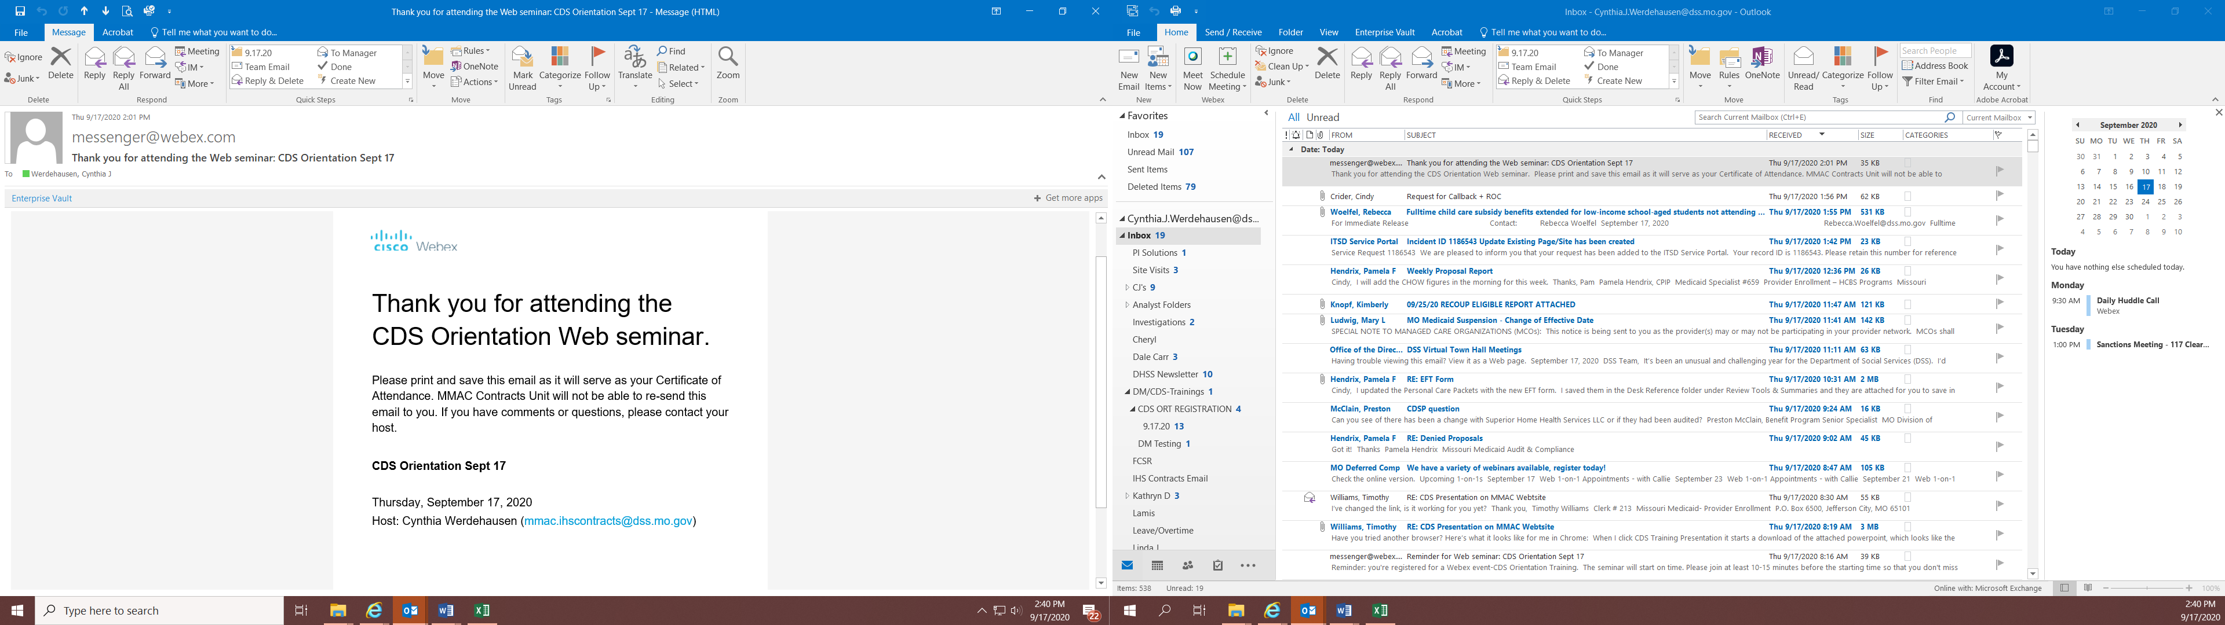
Certificate of Attendance

Slide 95
THANK YOU
Contact Info:
Cindy Werdehausen
MMAC Contracts Unit
Please send emails to
mmac.ihscontracts@dss.mo.gov

