Slide 1

Missouri Medicaid Audit & Compliance
Provider Enrollment Unit
Notes:
Okay .. 4/17

Slide 2
Structured Family Caregiver Waiver (SFCW)
The Structured Family Caregiver Waiver was developed to provide an option for individuals ages 21 and older diagnosed with Alzheimer's or a related disorder who wish to live at home in the community and would otherwise require institutionalization in a nursing facility to remain in the community.
It became effective July 1, 2021
This waiver is unique in that it requires both the primary caregiver and participant to reside in the same home.
Only actively enrolled In-Home Services providers qualify to provide this service.
For information about how to start providing Structured Family Caregiver Waiver services, please refer to the DHSS memo from July 2021: https://health.mo.gov/seniors/hcbs/hcbsmanual/pdf/hcbs07-21-02.pdf
The DHSS Home and Community Based Services Manual outlines the program and the participant criteria: https://health.mo.gov/seniors/hcbs/hcbsmanual/pdf/3.60.pdf
Questions should be directed to the Bureau of Long Term Services and Supports (BLTSS) via email at LTSS@health.mo.gov

Slide 3

Today, 251 providers are enrolled to conduct reassessments for Medicaid participants.
Notes:
245 in October 2016 .. Okay 4/17

Slide 4

Terms & Conditions for Reassessment Providers
Effective September 1, 2021, all newly applying reassessment providers are required to sign a Terms & Conditions agreement as part of their initial MO HealthNet enrollment.
Existing reassessment providers were contacted and asked to complete a Terms & Conditions agreement in order to continue providing reassessment services.
42 still have not returned their forms.
MMAC recommends you return the form as soon as possible to avoid any disruption in payments.
Notes:
Updated for Spring 2017 .. Okay 4/17

Slide 5
Change Requests & EFT forms
All MO HealthNet providers are required to keep their enrollment information current.
13 CSR 70-3.020 Title XIX Provider Enrollment (7) The provider shall advise the single state agency, in writing, on enrollment forms specified by the single state agency, of any changes affecting the provider’s enrollment records within ninety (90) days of the change, with the exception of change of ownership or control of any provider which must be reported within thirty (30) days.
Notes:
Okay .. 4/17

Slide 6

Change Requests
All changes in information must be reported, including phone #s, email addresses, directors, owners, etc.
Forms must be completed in full and signed.
All forms must have correct legal and DBA name.
Keep in mind: changes in address will require a site visit before they are approved. Most visits will be virtual, using FaceTime or other methods
Quick tip: include your NPI on emails and voicemails for faster service!

Slide 7

BANK CHANGES
Do not close your old bank account until you receive our payment into the new one.
Account change is not immediate. It takes 10 days from date of keying.
PAY TO: is it current?
We will attempt to validate the form with an authorized individual. If we cannot reach you using information on file with us (remember it is supposed to be kept current) then we will reject the request.

Slide 8
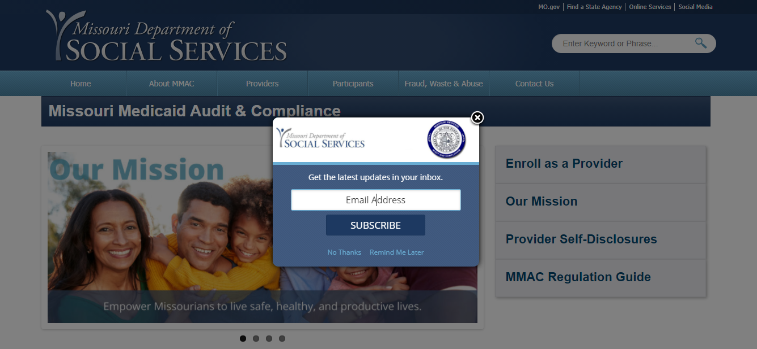
Sign up for Messages and Alerts from MMAC

Slide 9
Revalidation
Revalidating by EIN
Site visit required
Application Fee required -one fee per EIN
Contract will be renewed at the same time
Go to www.eMOMED.com to revalidate
FAQs: https://www.emomed.com/wps/.mmisAppsJSF/ExportServlet?filename=ProviderRevalidationFAQs.pdf
Required forms can be found here: https://mmac.mo.gov/revalidation-requirements/
Incorporating DocuSign

Slide 10
Accessing the Portal
1. Log into: www.emomed.com
2. Choose: ePassport
3. Choose: Provider Revalidation
On the Revalidation Search screen, set the search status to “All Started” or “All Not Started” to access all of your NPIs and their revalidation information.
If all of your NPIs are not listed, you will need to add them to your Admin or Sub-Admin screen under Manage NPIs. Links to do this are located on the first screen you see after you log in to ePassport.
If you do not see the Provider Revalidation button once you are logged into ePassport, contact the Help Desk @ 573-635-3559.
If you are having trouble navigating in the portal, call the Help Desk for assistance at 573-635-3559.

Slide 11
DOCUSIGN DEMO

Slide 12
Questions?
Contracts/Enrollment:
MMAC.IHSContracts@dss.mo.gov
(573)751-3399
Revalidation:
MMAC.Revalidation@dss.mo.gov
(573)751-5238
Notes:
Okay .. 4/17

