Slide 1


Division of Senior and Disability Services
Updates
Missouri Department of Health and Senior Services
October 2021

Slide 2
Organizational Updates
DSDS Division Director: Melanie Highland
Missouri Department of Health and Senior Services
DSDS Deputy Director: Kim Toebben
Asst. Section Administrator: Jessica Schaefer
HCBS Training Supervisor: Hether Larsen
Provider Reassessor Review Team

Slide 3

COVID-19 Updates
State flexibilities are extended though the State of Emergency Declaration, currently set to expire on December 31, 2021.
Missouri Department of Health and Senior Services
Federal flexibilities are extended through the Federal Public Health Emergency. It was extended last week until January 16, 2022. Will receive notification 60 days prior to termination.
These dates are subject to change upon extension of the State of Emergency or Public Health Emergency. Visit the site below to stay up to date on the latest extensions.
health.mo.gov/seniors/hcbs/covid-19-provider-info

Slide 4
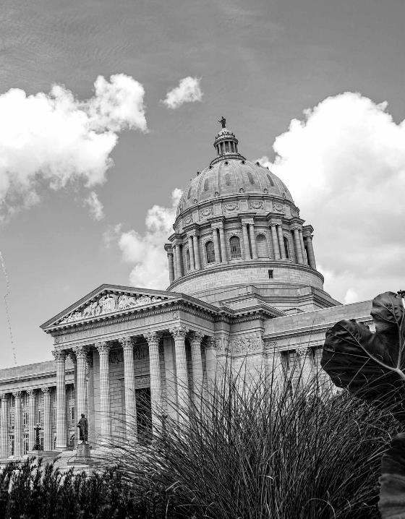
Regulations
CDS Regulations
Missouri Department of Health and Senior Services
House Bill 1682
Regulation Revisions
CDS
Personal Care
Service Standard Regulations

Slide 5
LOC Transformation
Jan 13 - Feb 19
Spring/Summer 2021
April 1, 2024
1915(c) Waiver public comment period
InterRAI-HC training
Transformed LOC only goes into effect
Fall 2020
Feb 16 - Mar 18
October 31, 2021
Stakeholder Engagement
Regulation public comment period
Dual LOC System goes into effect

Slide 6
LOC Transformation
Standard LOC is met
&
Transformed LOC is met
Select Transformed LOC
Standard LOC is met
&
Transformed LOC is not met
Select Standard LOC
Standard LOC is not met
&
Transformed LOC is met
Select Transformed LOC
Standard LOC is not met
&
Transformed LOC is not met
Select Transformed LOC

Slide 7
Provider Reassessments
LOC Provider Page
Updates
health.mo.gov/seniors/hcbs/loc-transformation
Missouri Department of Health and Senior Services
New terms and conditions went into effect September 1st.
A new policy focused on provider reassessors is available.
Provider Reassessment Page
New updated provider page with many resources.
health.mo.gov/seniors/hcbs/reassessment/

Slide 8

Provider Reassessment Training
health.mo.gov/seniors/hcbs/reassessment
Missouri Department of Health and Senior Services
Once all training videos have been reviewed, send qualifications and request for the test at ReassessorTraining@health.mo.gov
Certificates will be provided to individuals who pass the test with an 80% or higher.

Slide 9
Managing Your Health and Wellness
Grant funded opportunity through MA4
Missouri Department of Health and Senior Services
FREE health promotion classes for those enrolled in HCBS & their caregivers
Various six week, small group classes to choose from that help participants learn to manage chronic health conditions, develop healthy eating habits, and make action plans to enhance the quality of their lives
Classes may be in person, online, or over the phone
Notes:
MA4 was awarded a grant through Administration for Community Living (ACL). It provides an opportunity for free health promotion classes for those enrolled
In HCBS & their caregivers. It is a variety of classes that are evidence based. They are already proven to work.
For those interested, it is free and there will be link forthcoming on our Provider Page that will link to MA4 with a brochure with detailed information and contact information . Check it out!

Slide 10
HCBS Intake & PCCP Unit
The HCBS Intake & PCCP Unit is where new referrals and care planning requests for State Plan Services, Aged & Disabled Waivered Services, the Adult Day Care Waiver, the Independent Living Waiver, and the Structured Family Caregiving Waiver are processed.
HCBS Intake & PCCP operates as a State-wide Contact Center.
Contact Center Hours of Operation are Monday through Friday from 8:30 AM to 3:00 PM and closed all State & Federal Holidays, however the Bureau of Intake & PCCP is staffed from 8:00 AM to 5:00 PM.
Missouri Department of Health and Senior Services

Slide 11
Communicating with Intake & PCCP
Preserve phone lines for participants
Providers should use email or online options
Southwest MO
Southeast MO
East Central MO
Northwest MO
417-895-6455
573-290-5781
314-340-7300
816-889-2206
Missouri Department of Health and Senior Services
Central MO
Statewide
573-441-6222
866-835-3505
HCBS Referrals
Care Plan / Provider Changes
HCBSCallCenterReferrals@health.mo.gov
PCCP@health.mo.gov
Provider Reassessment Reviews
HCBS Intake & PCCP Management
ProviderReassessmentReview@health.mo.gov
HCBSIntakeAndPCCP@health.mo.gov

Slide 12
Communicating with Intake & PCCP
The call center is reserved for participants and others who have no other means to initiate referrals or requests. Providers and professional community partners should be directed towards electronic methods.
Utilize the “Communicating with HCBS Intake and PCCP Quick Guide” to ensure that your questions and requests get to the right people, right away!
The online referral and request form is the preferred method to submit new referrals and care plan change needs, as this method allows for increased efficiency with processing.
Missouri Department of Health and Senior Services

Slide 13
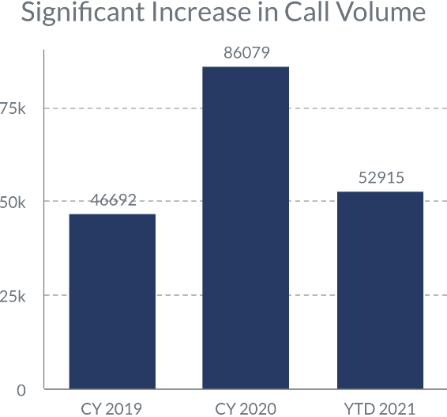
Intake & PCCP by the Numbers
There has been a significant increase in new referrals and care plan change requests for the HCBS program.
We are prioritizing participants that are in need of services to reduce significant health, safety, and welfare risk due to no formal or informal supports.
Missouri Department of Health and Senior Services

Slide 14
Intake & PCCP Considerations
Please help us prioritize our most vulnerable participants! You can help by providing details on the referral/request form about:
Recent hospitalization or facility stays
New serious, life altering health conditions or deteriorating health conditions
Formal supports
Home health, hospice, etc.
Informal supports
Back-up plan, family, friends, etc.
Health, safety, welfare risks
Missouri Department of Health and Senior Services
Please ensure that you are completing the PCCP Request Form
accurately. Utilize the new instructions to make sure you requesting the appropriate action.

Slide 15
Intake & PCCP Considerations
Please reference Cyber Access Web Tool prior to submitting any new referrals/requests to verify eligibility and check on the status of pending referrals.
It is imperative that only one route (online submission or email) is used per referral/request. Submitting duplicate or multiple referrals/requests for the same participant will result in a processing delay for all parties involved.
When submitting multiple referrals/requests in one email, each referral/requests needs to be uploaded or scanned into separate attachments. Multiple referrals/requests scanned into one running document cannot be processed.
All electronic communication should be sent to the Department via “encrypted email” in compliance with HIPAA privacy regulations. 45 CFR Section 164.312(a)(2)(iv) and (e)(2)(ii), specifically addresses the encryption requirements and standards under the HIPAA regulations. Encryption Instructions can be found here.
Each email account is reserved for its stated purpose only. Submitting questions to the incorrect referral or request accounts will result in a processing delay for all parties involved.
There has been a significant increase in referrals/requests, which may result in a processing delay. DSDS will contact all necessary parties to continue the referral/request process. Thank you for your patience as we work diligently to process all incoming referrals and requests as soon as possible.
Missouri Department of Health and Senior Services

Slide 16
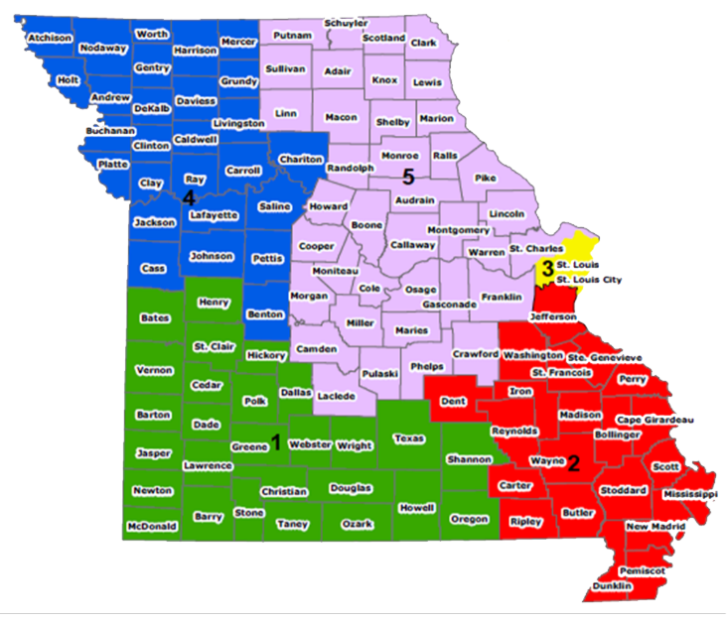
Special Investigations Unit
Region 1
Greg Backers, SIU Investigations Manager
Eric Johnson, APS Regional Manager
Region 2
Missouri Department of Health and Senior Services
Danny Ware, SIU Investigations Manager
Kevin Morgan, APS Regional Manager
Region 3
Mindy Sweezer, SIU Investigations Manager
Stacey Garner, APS Regional Manager
Region 4
Jamie Roe, SIU Investigations Manager
Megan Phillips, APS Regional Manager
Region 5
Zachary Jenkins, SIU Investigations Manager
Carey Boyer, APS Regional Manager
SIU@health.mo.gov

Slide 17
Investigation Process
1.
Complaint made to the Central Registry Unit (CRU)
5.
Submitted to the Office of General Counsel (OGC) for placement
2.
6.
Also submitted to MMAC and the MO Attorney General- Medicaid Audit & Compliance
Missouri Department of Health and Senior Services
Routed to SIU based on the zip code
3.
May also be routed to Protective Services for an assessment to see if services are needed for the client
7.
May be submitted to the local prosecutor for their review
4.
An investigation is completed and a determination is made based on the outcome of the investigation

Slide 18
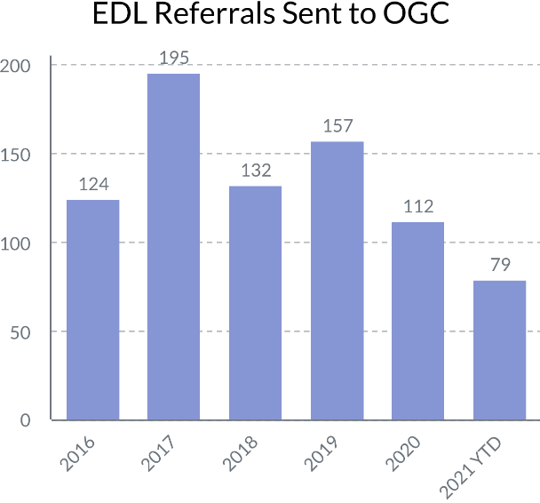
EDL Numbers
Missouri Department of Health and Senior Services
MMAC and MFCU Submissions
2018: 44 referrals sent to MMAC/MFCU
2019: 68 referrals sent to MMAC/MFCU
2020: 43 referrals sent to MMAC/MFCU
2021 YTD: 25 referrals sent to MMAC/MFCU

Slide 19
Case Example 1
The Facts:
SIU receives a report through CRU as EDL/Falsification.
The Reporting Adult (RA) and Alleged Perpetrator (AP) are friends.
Initial investigation shows that while working for the RA in the CDS program, the AP also maintains a full time job. Timesheets state the RA is receiving services for 3 hours and 45 minutes, 7 days a week.
Missouri Department of Health and Senior Services
RA stated that AP came 7 days a week, in the evening, and worked 3.5 hours
RA admitted to "clocking in" her attendant and that sometimes the attendant wasn't present.

Slide 20
Case Example 1
The Investigation:
RA admitted that "she did it, but not knowingly".
AP admitted to working 4 days a week for 4 hours a day since 2013, but had quit working as an attendant.
AP admitted to signing the training packet on how to document time. Investigator had both employment timesheets and showed how he could not have been in two places at once.
AP denied all the timesheets were submitted by him.
AP stated he hasn't worked for the RA since 2015.
Missouri Department of Health and Senior Services
The Outcome: 2,177 hours of fraud found

Slide 21
Case Example 2
The Facts:
Police department calls SIU for assistance with a case including use of a credit card without authorization.
SIU takes over investigation and subpoenas bank records of the RA.
The records show recurring PayPal transactions.
The PayPal account lists a name similar to an aid that previously worked for the RA.
A check of records showed the AP worked in the RA's home for approximately 5 weeks.
Missouri Department of Health and Senior Services
The Outcome: Investigator found 56 total transfers related to the account for $957.00

Slide 22
Case Example 3
The Facts:
A card was cancelled and a new card was ordered with 53 subsequent attempts to charge to the card.
The monies transferred were in small, unique amounts. An interview with the RA revealed that the aid had been the only person with access to the card.
The RA became sick over the incident and began to struggle financially.
Missouri Department of Health and Senior Services
The Outcome: The Prosecuting Attorney filed 3 charges
1 count felony - stealing
1 count felony - Abuse of a Health Care Recipient
13 counts misdemeanor - Fraudulent Use of a Credit Device

Slide 23
Case Example 4
The Facts:
The RA reports that 3 diamond rings are missing from her residence.
The RA believes that one of the in-home aids are responsible as the rings were in the home when the aids were cleaning and no others had been in the home.
The local police are called and a report is made. The police ask SIU for assistance.
Through the investigation, one ring is located in a pawn shop and identified by the RA.
The AP is taken into custody and confesses.
Missouri Department of Health and Senior Services
The Outcome: 1 count felony - stealing

Slide 24
Case Example 5
The Facts:
The RA reports that someone has taken a promissory note for a student loan in her name for $18,000.
It is determined that a former in-home aid may be responsible.
SIU obtains the loan documents, connects phone numbers from the loans to a former aid.
Other records and documentation show that monies from the loan went into accounts belonging to the former aid.
Missouri Department of Health and Senior Services
The Outcome:
1 count felony - forgery
1 count felony - Abuse of a Health Care Recipient
4 counts felony - Identity Theft
Case was transferred to the Federal Prosecutor

Slide 25
Questions?
Missouri Department of Health and Senior Services

